Slide 1
Introduction to Mapping in R
Paul Egeler
WMRUG
21 March 2017

Slide 2
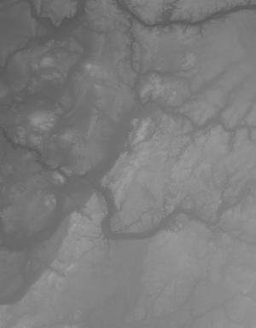
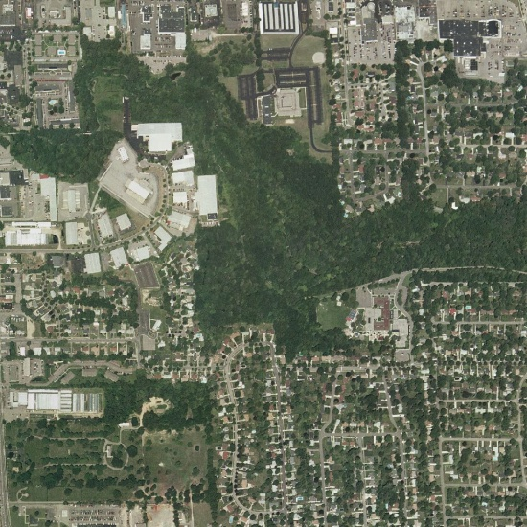

Geographic Data Types
Raster
Vector
Basemaps
Satellite/Areal Imagery
Digital Elevation Models
Points
Lines
Polygons
Topology

Slide 3
Shapefiles
Collection of files in the same directory
.shp: Geometry
.shx: Index
.dbf: Attributes
.sbn: Spatial index
.prj: Projection
Many more…
All files must have the same root filename
REQUIRED
OPTIONAL

Slide 4
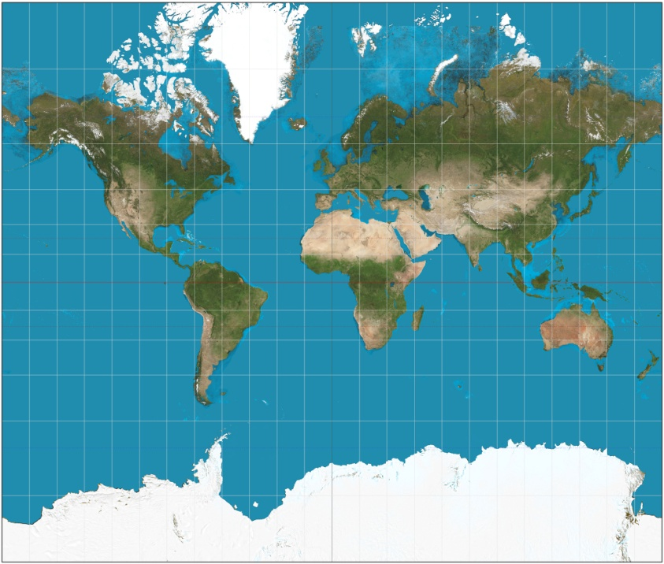
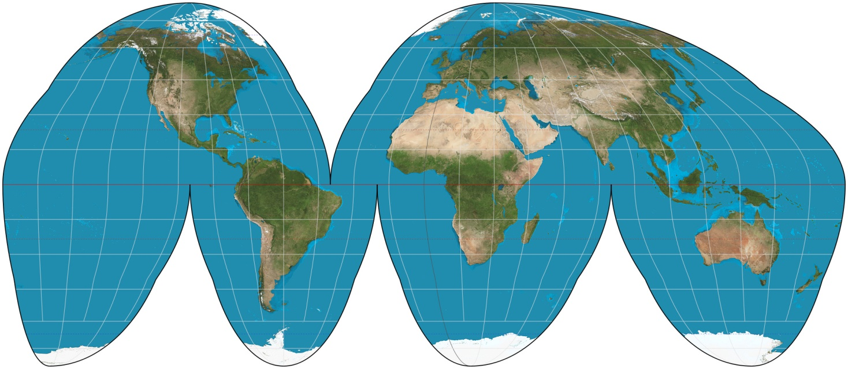
Coordinate Systems and Projections
Coordinates
WGS84 - World
NAD83 – North America
Projections
Conic (tan/sec)
Cylindrical
Planar
For more information:
http://desktop.arcgis.com/en/arcmap/10.3/
guide-books/map-projections/projection-types.htm
wikimedia.org

Slide 5
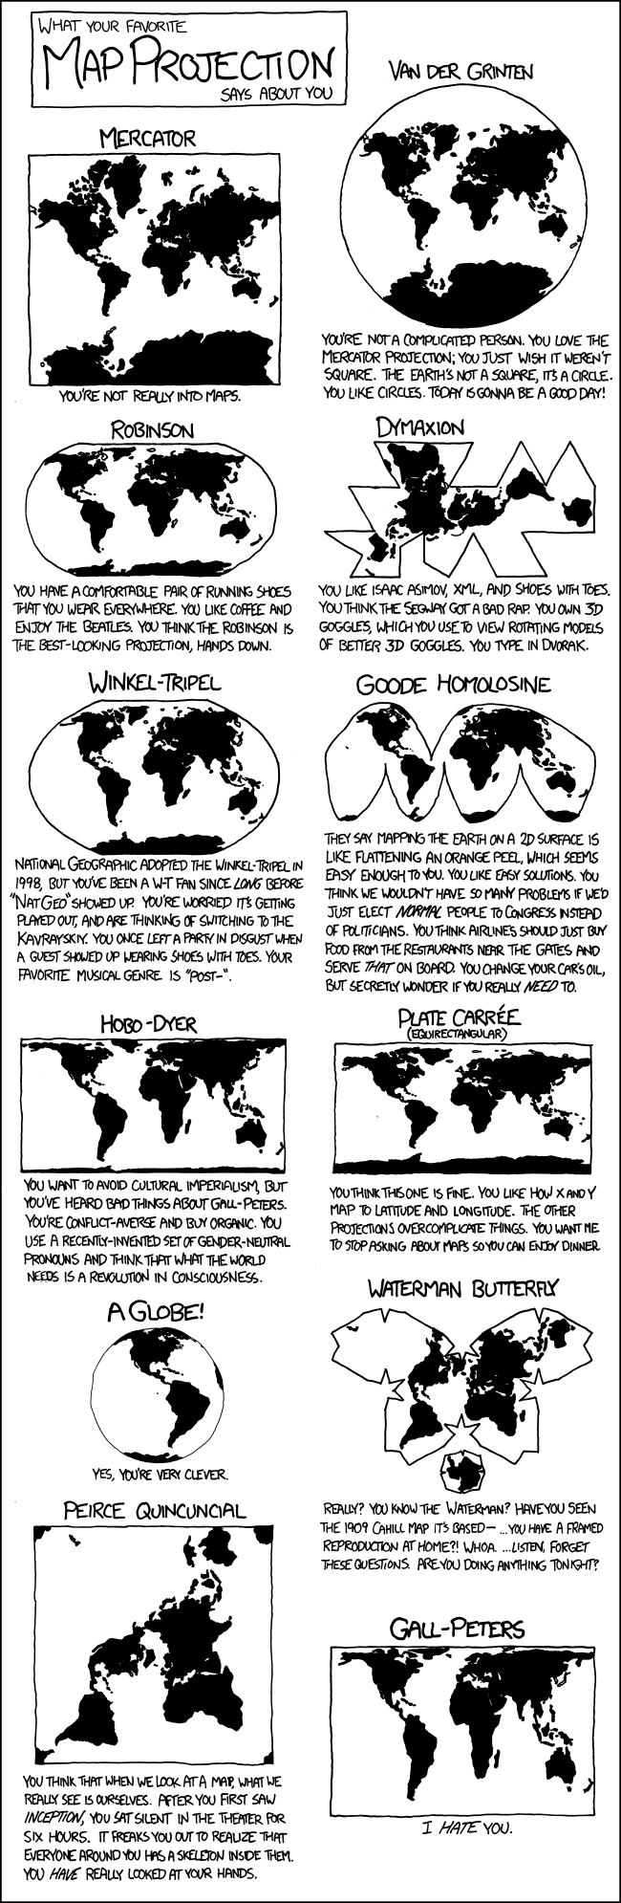
Coordinate Systems and Projections
https://xkcd.com/977/

Slide 6
Geographic Data Sources
On Demand thru API
Saved to Local Disk
Open Street Map
Google Maps
US Census (ACS)
Self-generated
Government
State/Local/County
USGS
US Census
BLS
DATA.GOV
Commercial
Always remember to check licensing on data gathered!

Slide 7
R Mapping Packages
maps
maptools
RgoogleMaps
OpenStreetMap
ggmap
choroplethr

Slide 8
Demonstration

Slide 9
Questions?

